Slide 1

Notes:
Presenter Tip:
Welcome all and thank them for attending to learn about the Arbonne Opportunity.
Think about a personal story to help break the ice:
Allow your audience to connect with you on a more personal level and show your vulnerability. This drives home your credibility, makes you more real and genuine.
Help your personal stories come to life by following the guidelines found on The Source > B.E.S.T. (Compliance) Protecting Your Business > Income & Product Claims.

Slide 2
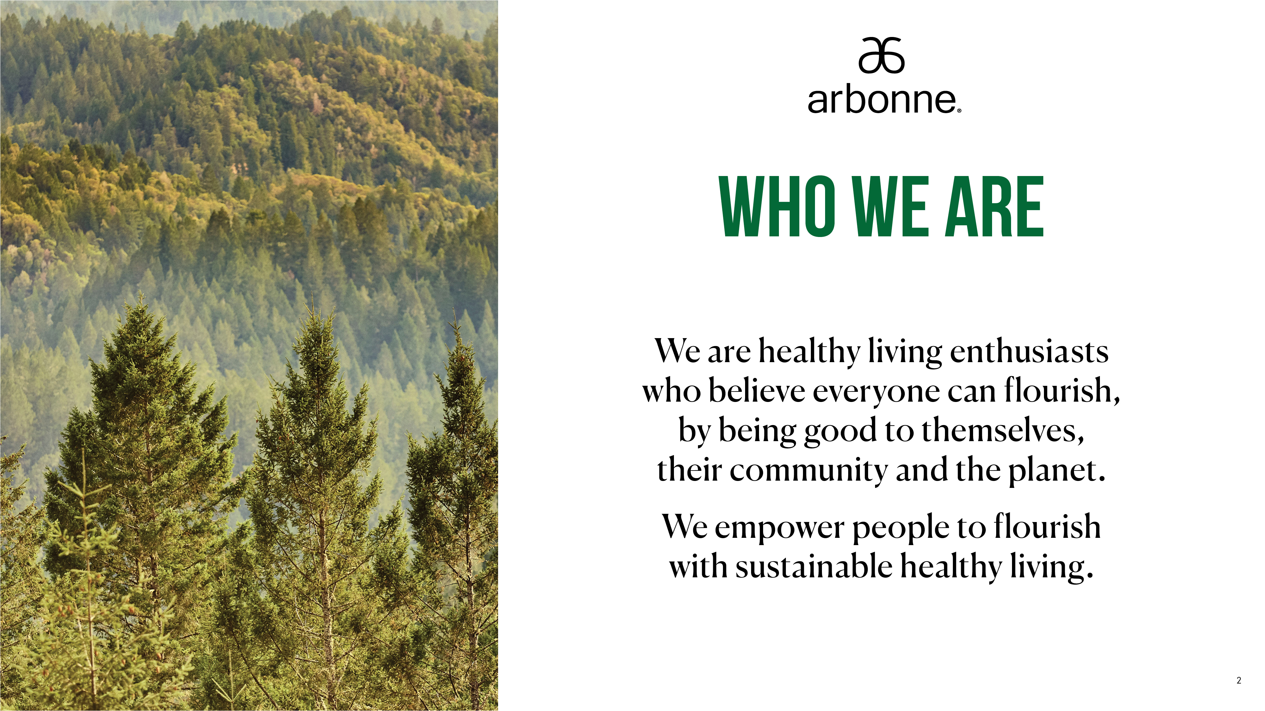
Notes:
Transition:
With my Arbonne business, I am in charge of my life and have the ability to empower others by helping them start their own healthy living journey and for some, a new business.
Talking Points:
We follow a stringent ingredient policy resulting in clean nutrition, skincare, body care, hair care and makeup products. Our product philosophy embraces the connection between a healthier mind, stronger body, and more beautiful skin.
Arbonne was founded in 1980 by Petter Mørck, who set out to develop, produce and market skincare and related products unparalleled in quality, purity, safety and beneficial results.

Slide 3
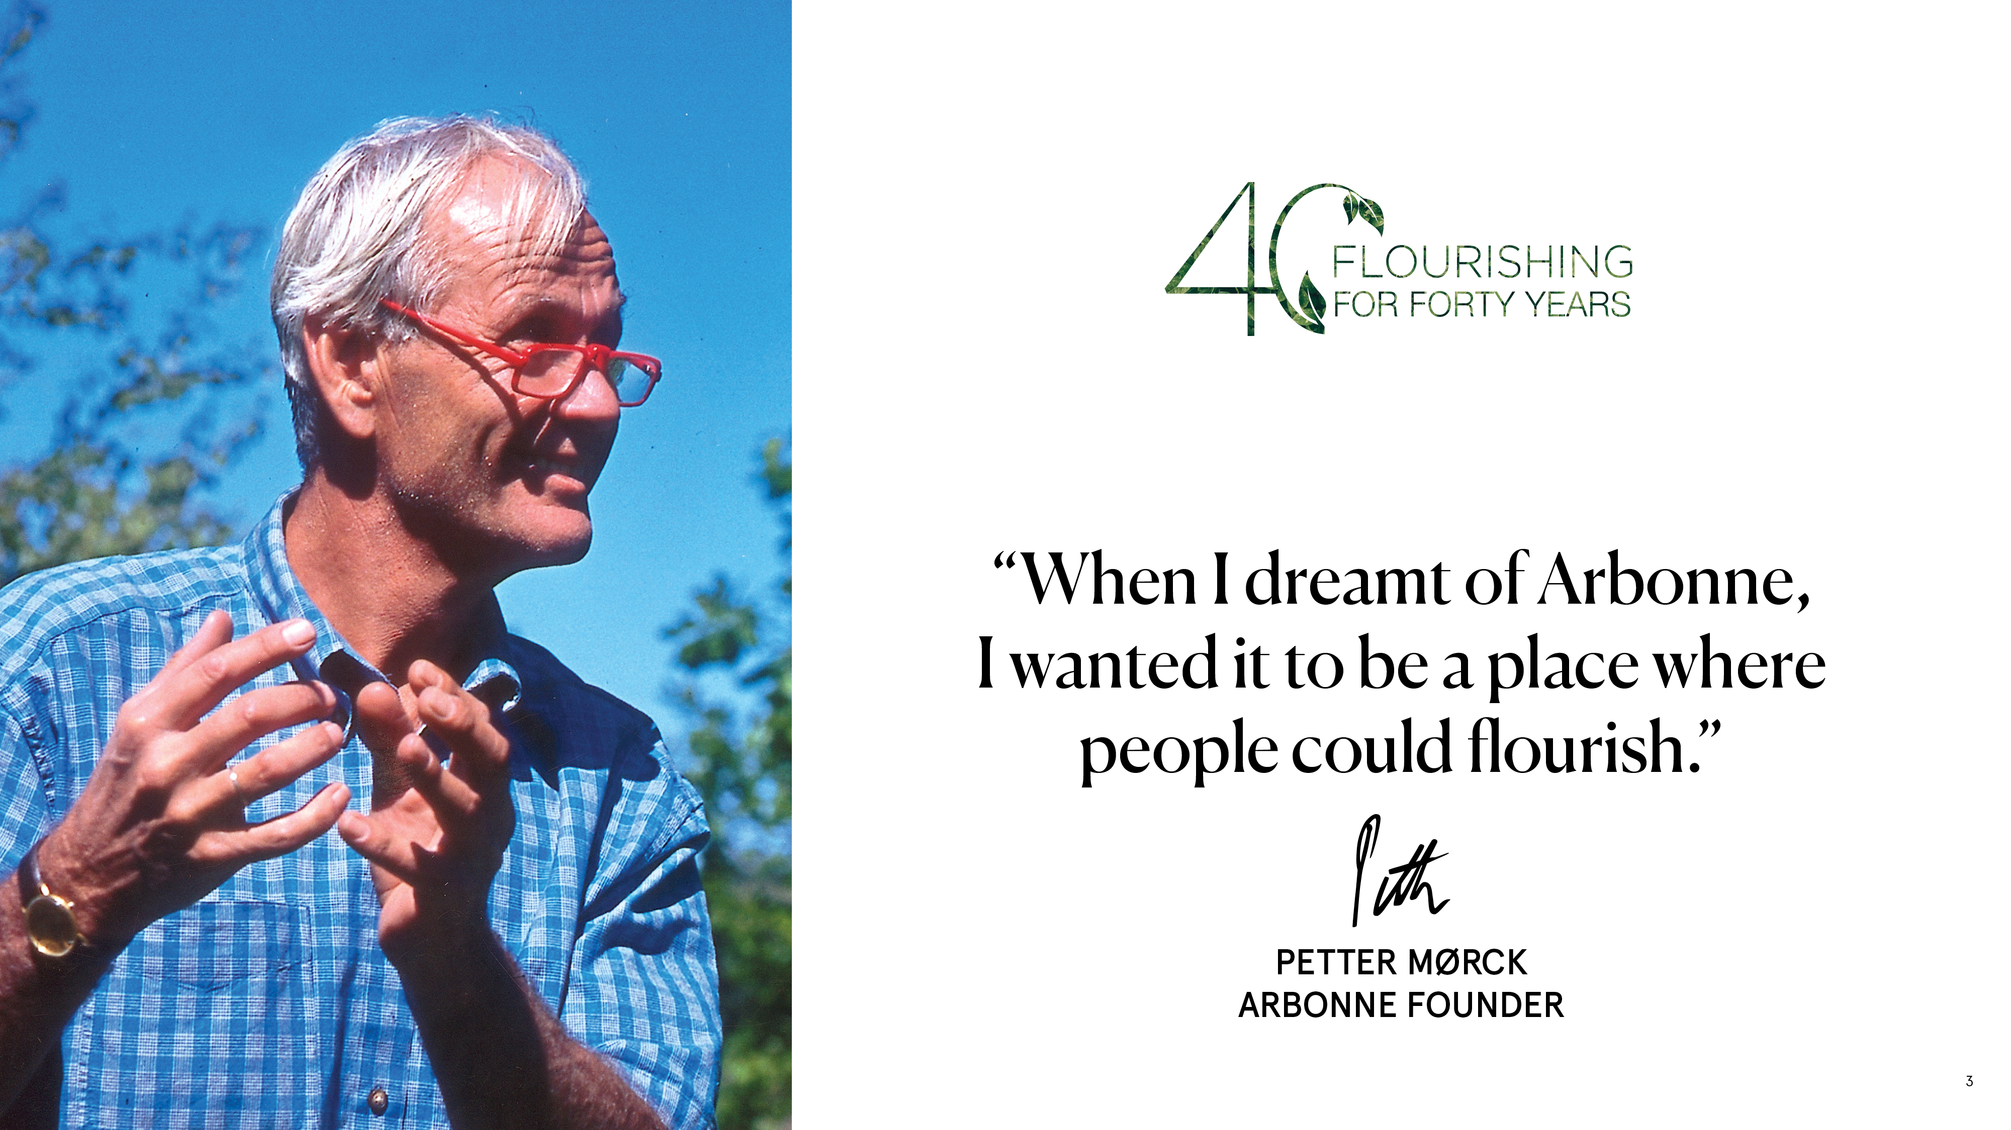
Notes:
Presenter Tip:
Talk about what the Founder’s vision means to you and why it is important to you.
Talking Points:
Petter’s purpose was to create and organize meaningful and challenging opportunities for people seeking personal, professional, social and cultural opportunities and rewards superior to anything available in the industry.
We know today the world is aligned with our belief and we operate in 6 countries across the globe.

Slide 4
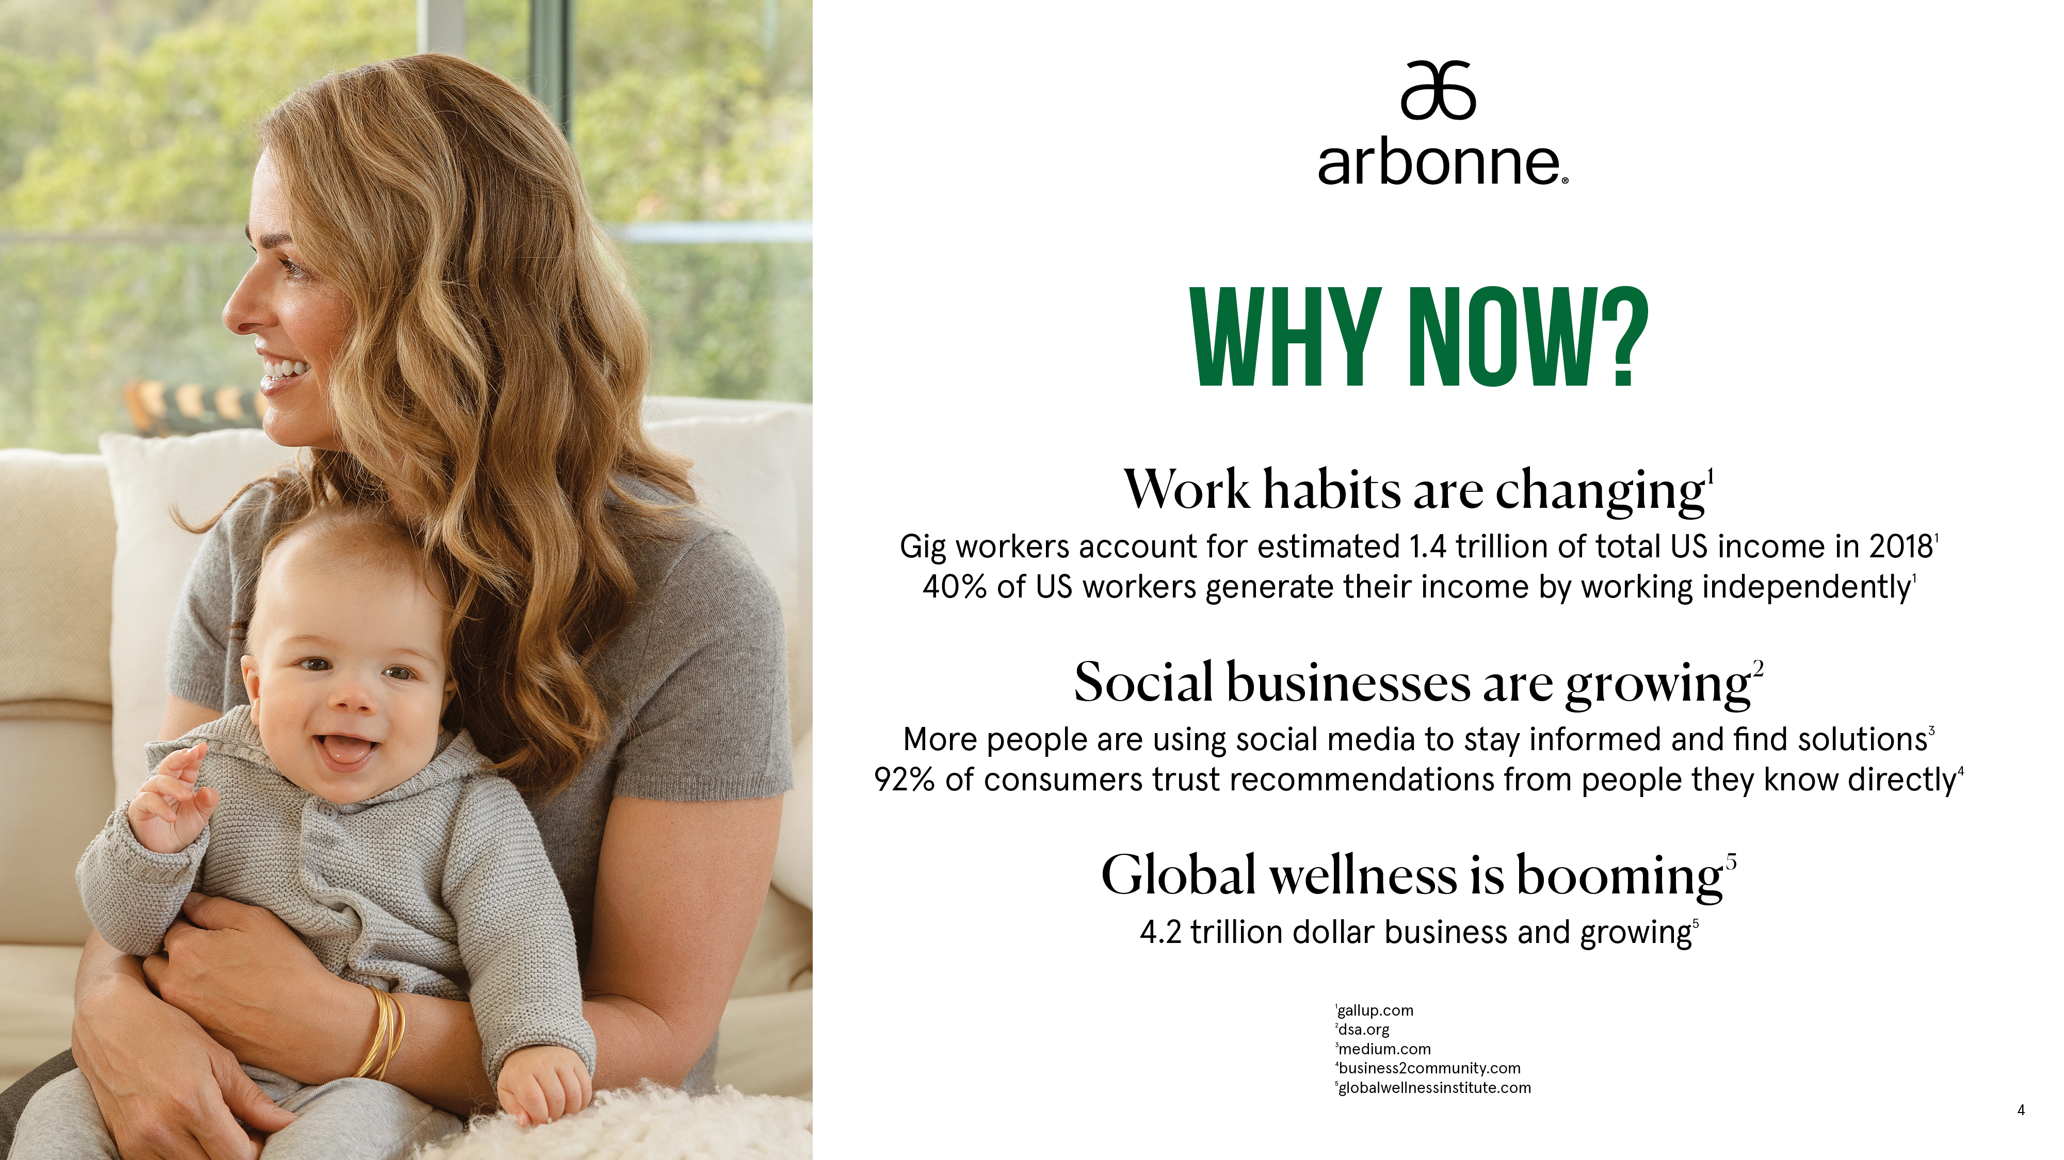
Notes:
WHY NOW?
Work habits are changing¹
Gig workers account for estimated 1.4 trillion of total US income in 2018¹
40% of US workers generate their income by working independently¹
Social businesses are growing²
More people are using social media to stay informed and find solutions³
92% of consumers trust recommendations from people they know directly⁴
Global wellness is booming⁵
4.2 trillion dollar business and growing⁵
Reference:
1 gallup.com
2 dsa.org
3 medium.com
4 business2community.com
5 globalwellnessinstitute.com

Slide 5
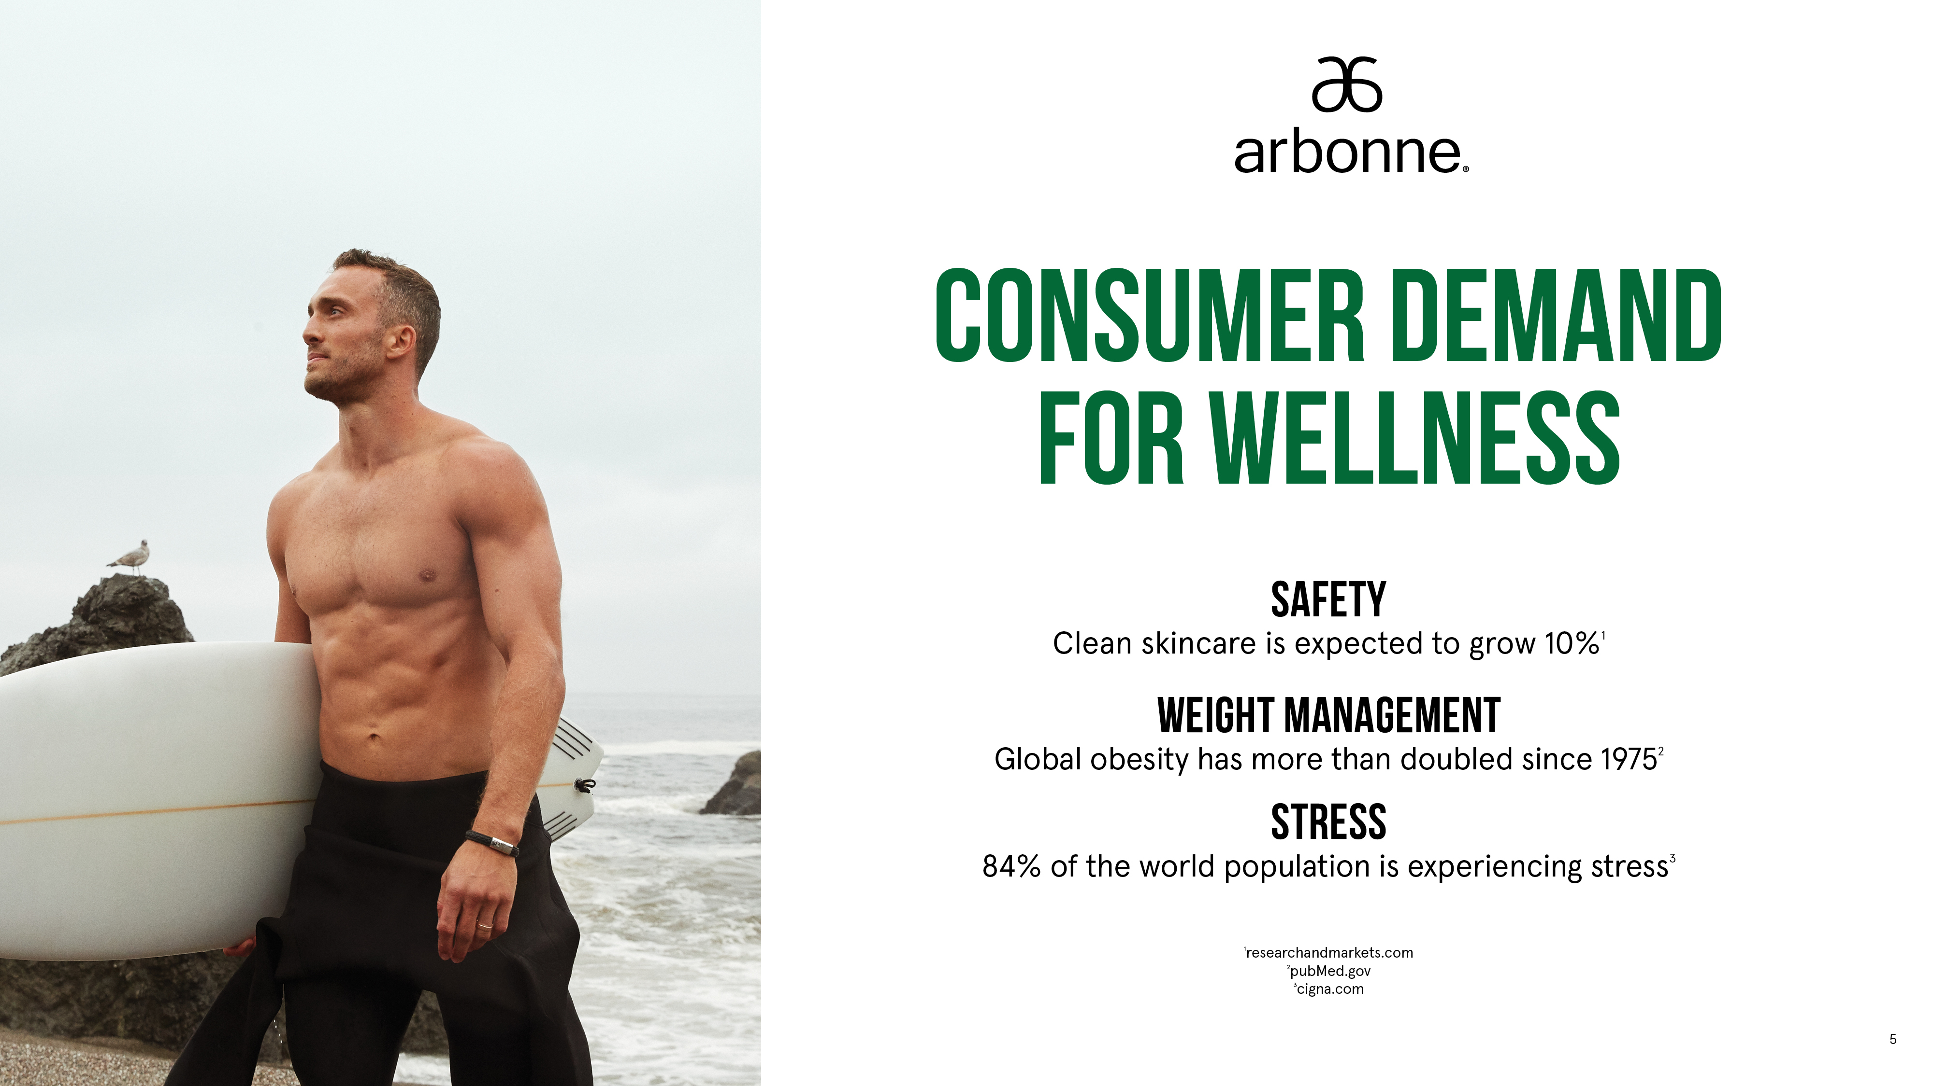
Notes:
CONSUMER DEMAND FOR WELLNESS
SAFETY
Clean skincare is expected to grow 10%¹
Weight Management
Global obesity has more than doubled since 1975²
Stress
84% of the world population is experiencing stress³
Reference:
1 researchandmarkets.com
2 pubMed.gov
3 cigna.com

Slide 6
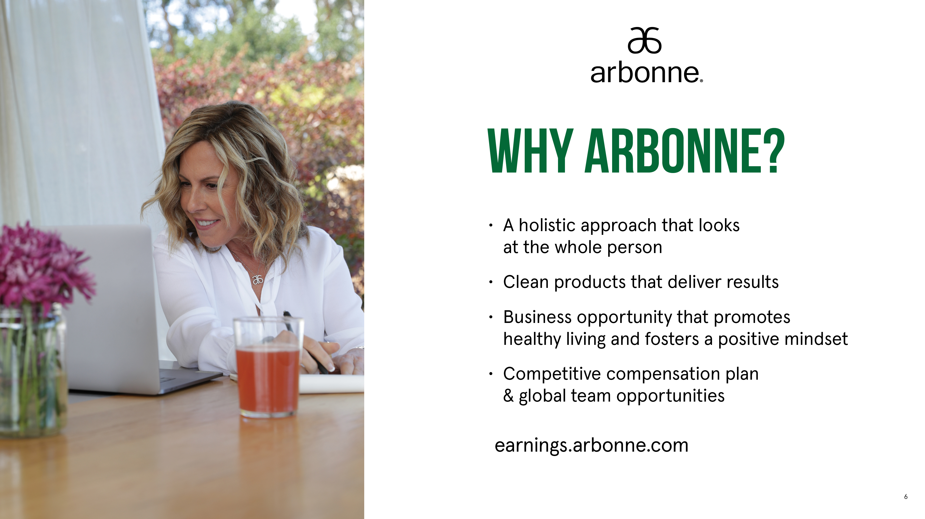
Notes:
Transition:
Why Arbonne? Arbonne is uniquely positioned to lead the revolution of the global wellness market by providing safe and healthy products.
Talking Point:
We’re a passionate community of Independent Consultants who grow in their Arbonne journey together.
Arbonne empowers people to be the best that they can be. We have a 40-year history and a holistic product philosophy that focuses on the whole person. Arbonne products deliver results, supporting a healthy lifestyle for the entire family.

Slide 7

Notes:
We believe in a holistic approach to beauty, health and wellbeing, focusing on the whole person from the inside out.

Slide 8

Notes:
Talking Point:
We continually challenge ourselves to be transparent and deliver the best of science and nature by creating effective products you can trust. Our product philosophy is comprised of four key factors and rooted in science. These pillars are our competitive advantage.
NOTE TO PRESENTER: Not all certifications apply to every product in Arbonne’s portfolio. Please be sure not to misrepresent certification status.

Slide 9

Notes:
Transition:
Arbonne is also committed to increasing its sustainability measures by decreasing waste, reducing plastic, and increasing recycling. As a Certified B Corp, we’re held to higher standards across multiple measures of accountability including environmental impact, customer welfare, and social impact.
Talking Point:
Our goal is to advance our leadership in the social responsibility landscape and use the power of our business as a force for good.
We are a certified B Corporation.
We have partnered with TERRACYCLE® to recycle hard-to recycle pieces, starting in the US with the goal to expand the program to other countries.
We have a goal to reduce our carbon footprint by 30% by 2030 and we are already 22% there.
Presenter Tip:
Share why this is personally important to you.

Slide 10

Notes:
Talking Point:
Arbonne is a purpose-driven company, and we offer a wide range of consumable vegan products for the entire family.

Slide 11

Notes:
Transition:
Our 30 Days to Healthy Living Program is ideal for individuals looking to improve their eating habits, have more energy, and boost their confidence. It refocuses your habits on eating and living consciously.
NOTE TO PRESENTER: Arbonne’s products are not tested to support weight loss. Do not confuse Arbonne’s products or 30 Days to Healthy Living with a weight loss program.

Slide 12

Notes:
Transition:
By balancing nutrition and effective skincare like RE9 Advanced, our clients experience the ultimate in healthy living from the inside out.
Talking Point:
RE9 Advanced was developed after 3 years of research and testing. The bestselling formula features gold standard ingredients including vitamin C and orange stem cells.
RE9 Advanced products contain ingredients that help improve the appearance of skin firmness, elasticity and tone, while minimizing the appearance of fine lines and wrinkles through hydration. Use consistently, morning and night for best results.

Slide 13

Notes:
Talking point:
Refer anyone with questions to earnings.arbonne.com.
Independent Consultants share the products they love with their network in-person and online and earn commission on products they sell.

Slide 14

Notes:
Talking point:
Refer anyone with questions to earnings.arbonne.com.
Everyone Can Flourish with Arbonne
We champion authenticity through a passionate community that’s diverse, inclusive and welcoming.

Slide 15

Notes:
Talking point:
Refer anyone with questions to earnings.arbonne.com.
1- Commissions on your personal sales
2- Commissions from the product sales by your team (overrides)
3- Cash awards offered at every level based on sales performance

Slide 16

Notes:
Talking point:
Refer anyone with questions to earnings.arbonne.com.
MAKE HEALTHY LIVING YOUR BUSINESS
Our Independent Consultants:
• Own their Arbonne business
• Can run their business on the go from their phone
• Share products they love and earn money on product sales
• Support each other through teams that teach each other about the business
• Share our mission for healthy living to improve mind, body and skin
Or become a Preferred Client and shop at a 20% discount!

Slide 17
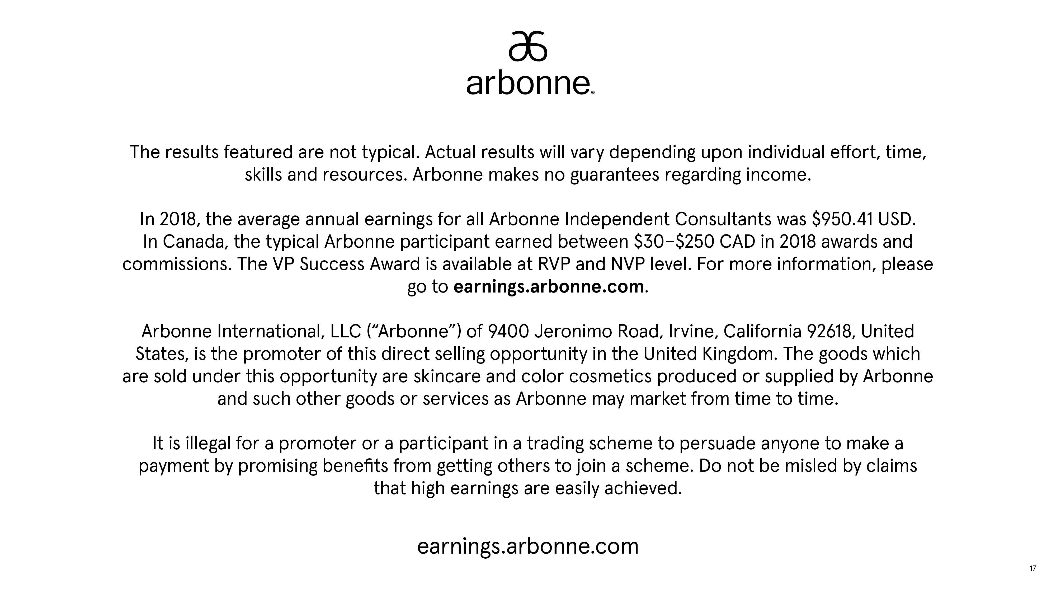
Notes:
Presenter Tip: Thank your guests and ask for questions.

